Slide 1


Students Result Management System
Submitted to the Department of Computer Science & Technology (CST) in partial fulfillment of the requirements for the Diploma in Engineering.
Presented By
Supervised By
Name: [Your Name]
ID: [Your ID]
Session: [Your Session]
Department of CST
Name: [Teacher's Name]
Designation: [Teacher's Designation]
Department of CST
Institution: Hemayetunnesa Memorial Polytechnic Institute
Sariakandi, Bogura, Rajshahi, Bangladesh.

Slide 2

Project Outline
This presentation covers the complete lifecycle of the Students Result Management System development, from conceptualization to final evaluation.
Introduction
Objectives
Context and problem statement.
Core goals and mission.
System Design
Implementation
Architecture and schema.
Technology stack and tools.
Testing & Evaluation
Result Analysis
Quality assurance steps.
Performance and feedback.

Slide 3

Introduction
The Students Result Management System is a full-stack web application designed to digitize the academic result processing of our institute. It moves away from antiquated methods towards a streamlined digital future.
The Problem
Manual result processing is error-prone, time-consuming, and difficult to maintain physically. Paper records are vulnerable to damage and loss.
The Solution
A web-based platform built with the MERN stack that automates result calculation and provides instant access to students and teachers via a centralized portal.
The core concept leverages Role-Based Access Control (RBAC) to ensure that Admins, Teachers, and Students interact with the data according to their specific permissions, maintaining high integrity.

Slide 4
Project Objectives
Our primary mission was to build a system that enhances institutional productivity while maintaining data accuracy.
Automation
Accessibility
Automate GPA/CGPA calculations and grade generation to eliminate human error during transcript preparation.
Provide a secure public search portal where students can instantly view and verify results using their roll numbers.
Efficiency
Security
Enable "Bulk Upload" functionality via Excel/CSV, allowing teachers to process entire departments in seconds.
Ensure total data integrity using JSON Web Tokens (JWT) for authentication and Bcrypt for password encryption.

Slide 5
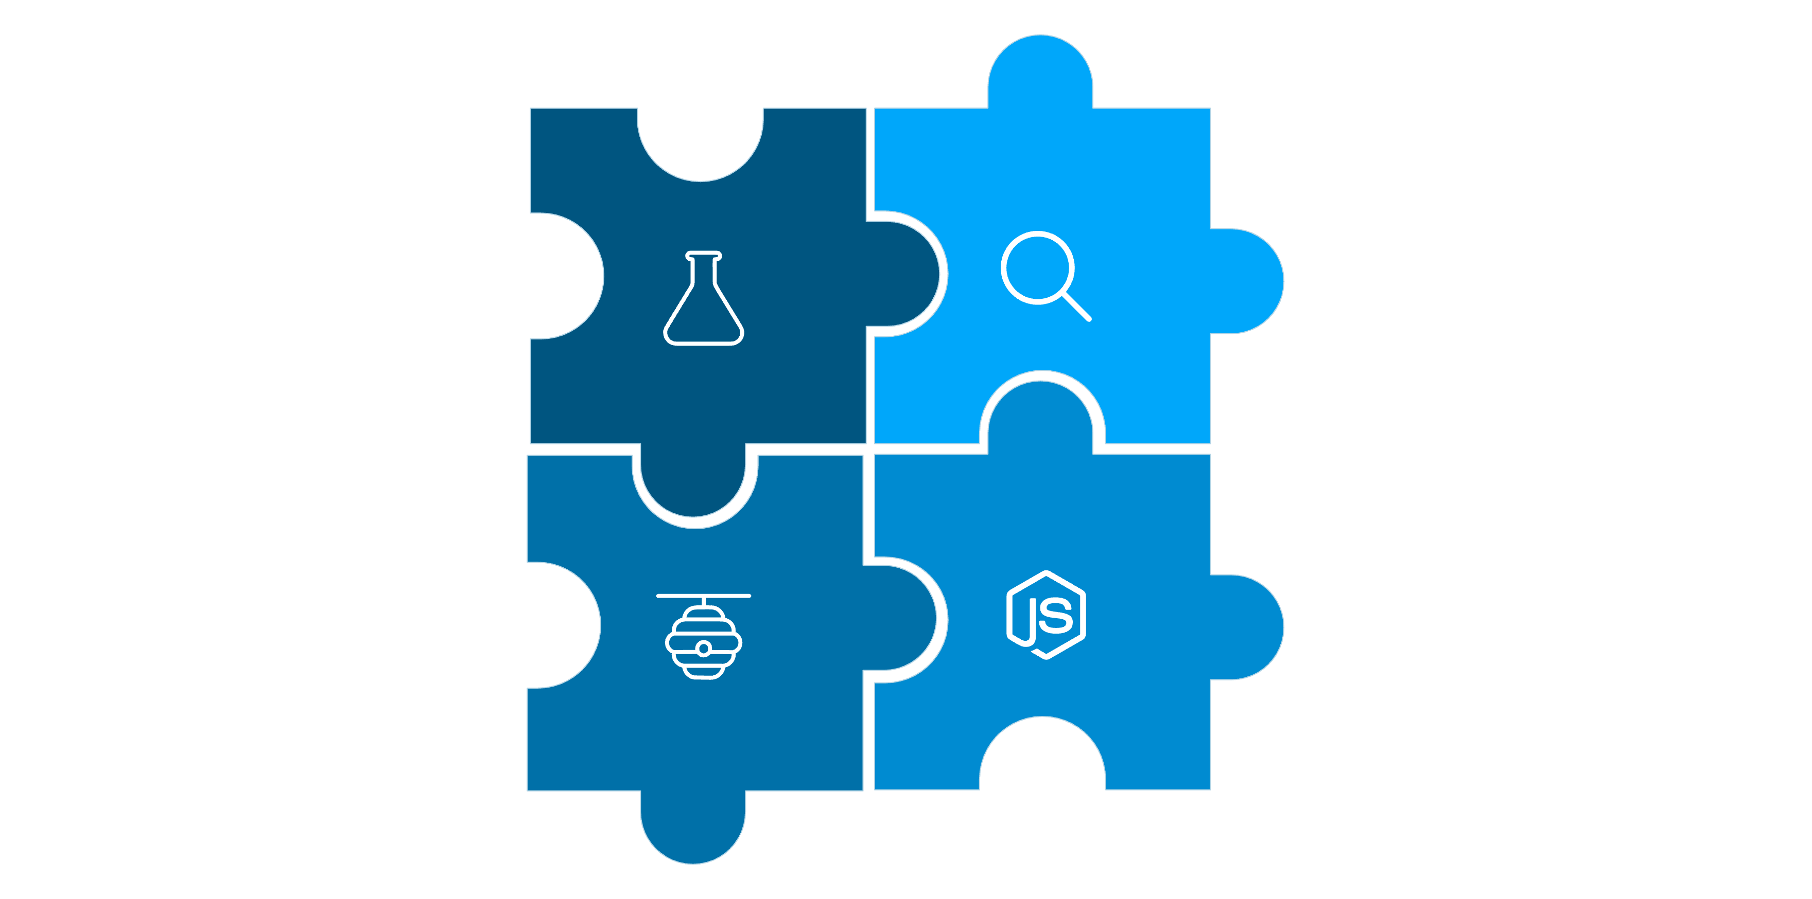
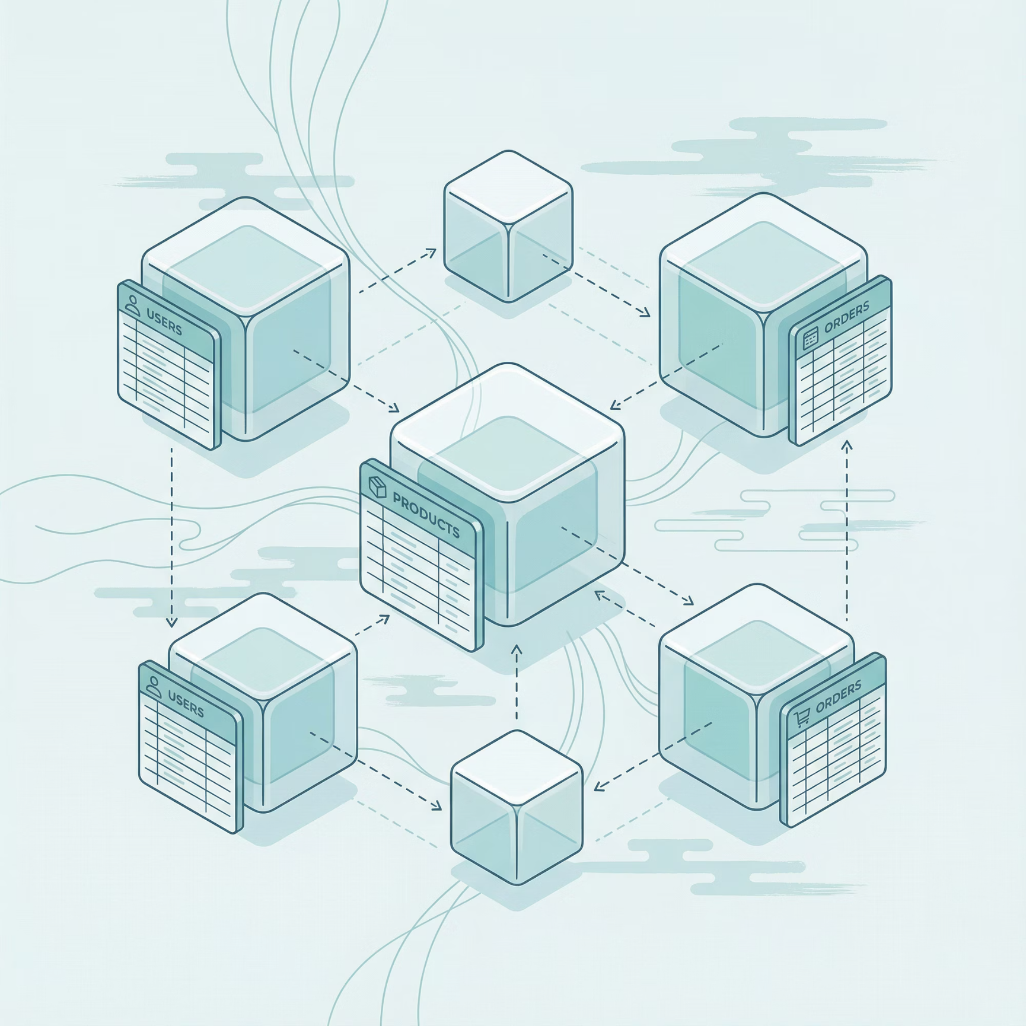
System Design & Architecture
The system is built on the Model-View-Controller (MVC) design pattern, ensuring a clean separation of concerns and scalability.
Client
Database
REST API
Server
Database Schema
Student: Personal profiles, roll/reg numbers, and department details.
Result: Subject-wise numeric marks linked via Student ID.
Users: Secure credentials with defined roles (Admin vs. Teacher).

Slide 6



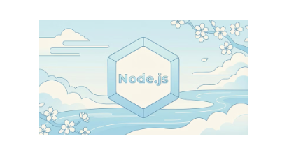
System Implementation
We selected the MERN Stack (MongoDB, Express, React, Node) to provide a seamless, single-language development environment from front to back.
Frontend
Backend
Data Tier
Built with React 19 and Vite for lightning-fast performance. Styled using TailwindCSS for a responsive, modern UI. Includes Framer Motion for smooth transitions.
Node.js and Express.js handle business logic. Security is bolstered by Helmet for header protection and Multer for handling file-based result uploads.
MongoDB provides a flexible NoSQL environment, managed via Mongoose ODM to ensure consistent data structures and fast indexing.

Slide 7
Testing & Evaluation
Rigorous testing was conducted to ensure the system remains reliable under heavy traffic and protects sensitive student data.
1
Unit Testing
2
Integration Testing
3
Security & RBAC
Individual API endpoints for Authentication and CRUD operations were validated using Postman to ensure 100% uptime of the logic layer.
Verified the seamless data flow between the React UI and the MongoDB database via our Express middleware.
Validated Role-Based Access Control to ensure students cannot bypass security to access the Administrative dashboard.

Slide 8
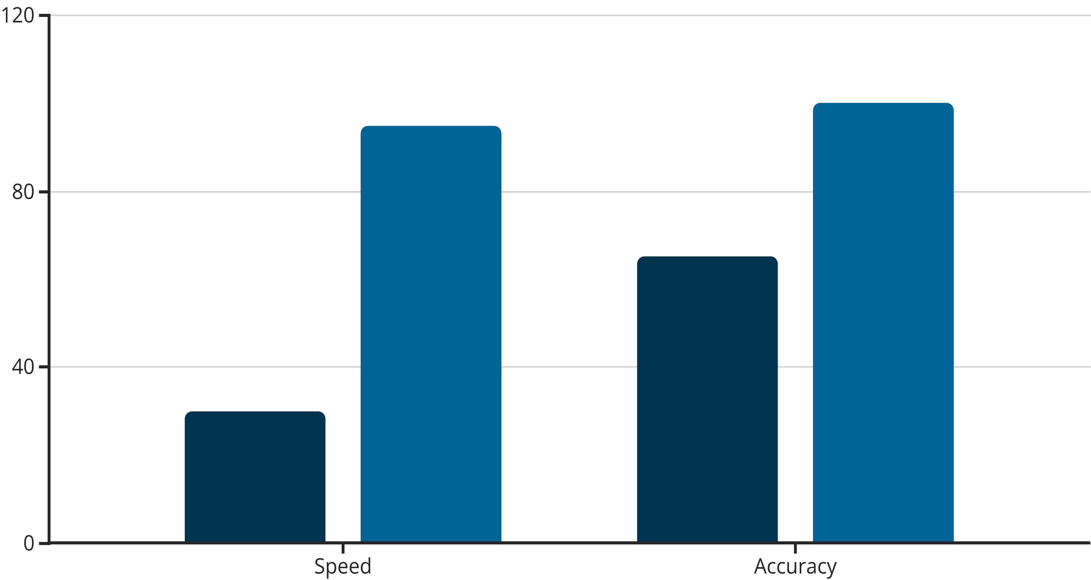
Result Analysis & Discussion
The implementation has shown significant improvements over traditional paper-based methods across all key metrics.
70%
0
100%
Time Reduction
Error Rate
PDF Accuracy
Processing time for end-of-semester results compared to manual entry.
Zero calculation errors found in GPA/CGPA generation during audit.
Automatic generation of professional transcripts without formatting issues.
Manual System
Digital MERN System

Slide 9
Conclusion & Future Scope
The Students Result Management System successfully bridges the gap between traditional record-keeping and modern digital demands.
Project Impact
Future Roadmap
Secure and scalable for future growth.
SMS Notification for results.
Standardized result reporting.
Integrated semester fee payment gateway.
Future-proof tech stack (MERN).
Mobile Application (Android/iOS).
"Our goal is to create a fully paperless academic environment for the Department of CST."
Thank You! Any Questions?

